Slide 1
Site Tweaks

Slide 2
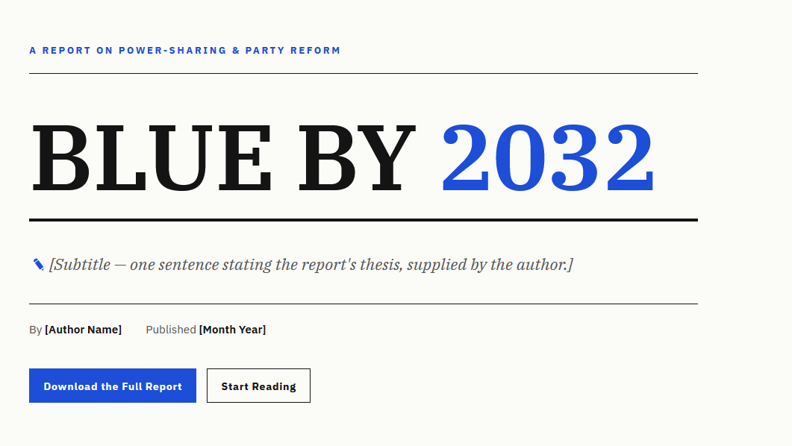
CAN THIS BE IN IMPACT TO MATCH THE DOC?
Designing Plans for and Pathways to Sustainable Democratic Majorities

Slide 3
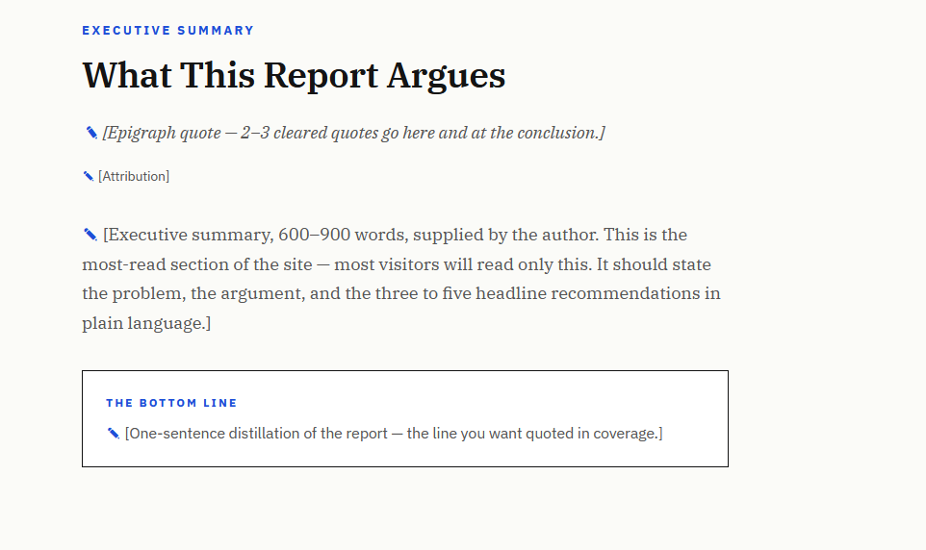
Change is a Choice
SEE COMPANION DOC
SEE COMPANION DOC

Slide 4
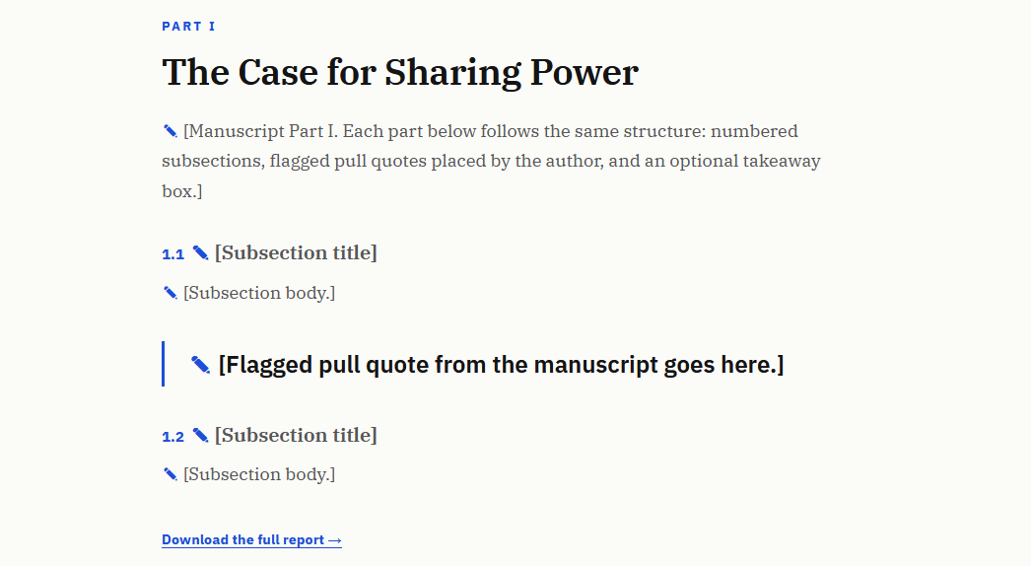
Ten Years for a Stronger Future
SEE COMPANION DOC

Slide 5
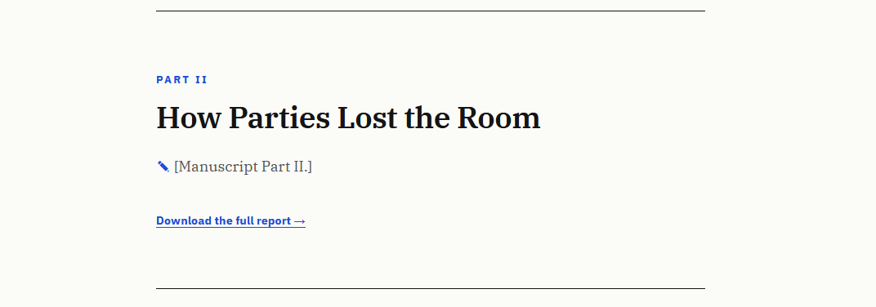
CAMPAIGN FUNDRAISING
SEE COMPANION DOC
SEE COMPANION DOC FOR THE REST OF THE SECTION RENAMING AND COPY

Slide 6
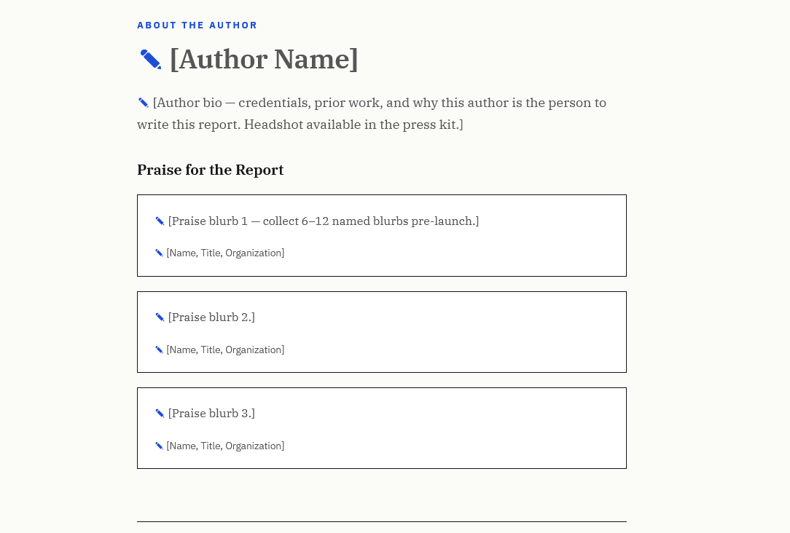

Slide 7
